Slide 1
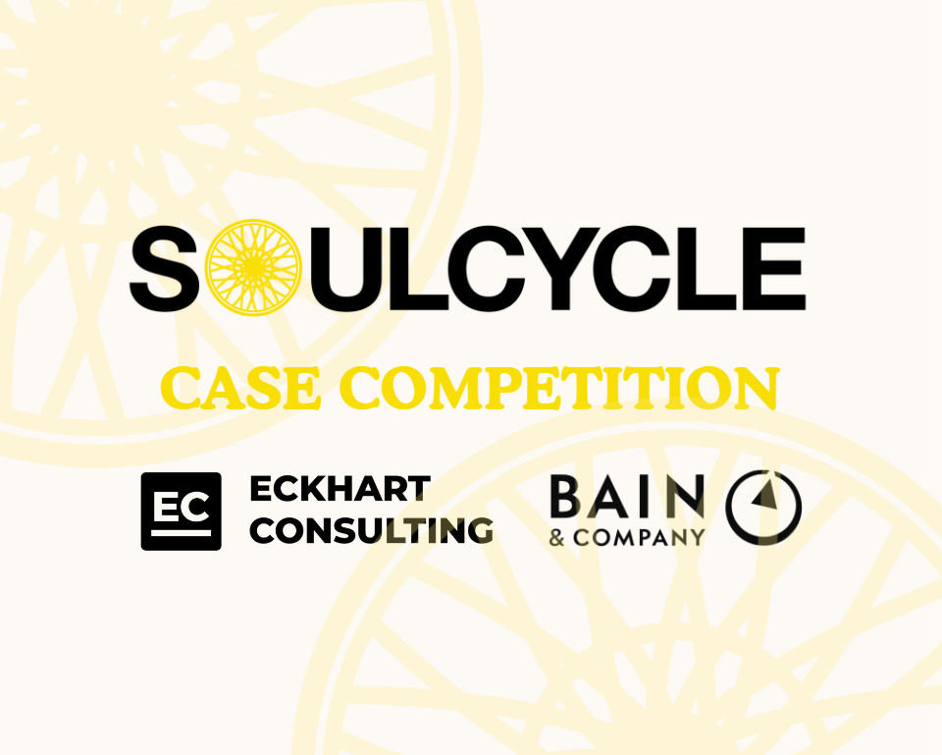

Slide 2
Table of Contents
April 17, 2024 Information Session
2
Competition Overview
Client & Sponsor
8
Case Question
Scope Information
10
Conclusion
Questions & Resources

Slide 3
What is a Case Competition?
General Overview
Key Factors
A case competition presents a business problem, and after a limited timeframe, has teams present their solution to a panel of judges. Teams are expected to analyze the case, develop a course of action, and prepare a deliverable (presentation) to showcase their findings.
Teams compete as individuals or groups, with a maximum limit of 4
Deliverable can include strategy, marketing, financial projections, etc.
Focus on the rational behind the recommendations you present
Presentations are judged by full- time consultants in the first round and by SoulCycle execs in the final round
Most importantly, case competitions are supposed to be fun!
The case competition team is very excited about our client and sponsors, and the problem that they’ve asked us to answer. We hope you are too!

Slide 4
2024 Case Competition Logistics
Dates & Deadlines
First Entry Submission
Final Round Presentations, Judged by SoulCycle
Timeline
April 17
April 20
April 24
May 3
Information Session
Second Round Presentations, Judged by Bain
Office Hours with the EC Case Competition Team will be held from 1-2pm CT on Friday (4/19) in Reg Room 404

Slide 5
Submission Criteria / Rubric
What are our judges looking for?
Responses will be evaluated according to case strategy and presentation
Case Strategy
Presentation
Identify the most promising ideas
Tell us why they’re promising
1
Substantive
Your solution should be creative, original, and insightful
1
Narrative
Present an easy-to-follow narrative with clear arguments and takeaways
2
Implementable
Your solution should be cost-effective, realistic, and time-sensitive
2
Formatting
Keep format consistent, professional, and concise
Evidence-Backed
Your solution should prove to the judges that it meets their criteria using sufficient argument and evidence
Speaking Skills
Speak slowly and clearly, practice ahead of time to avoid reading
3
3

Slide 6
Client Information
SoulCycle
Client Background
SoulCycle is a multinational fitness company owned by Equinox Group, offering indoor cycling and spinning workout classes domiciled in Delaware and headquartered in New York City.
It was founded in 2006 as an indoor cycling studio and has expanded to also sell athletic wear, and accessories. In 2011, Equinox acquired a majority stake in SoulCycle
SoulCycle currently has outlets in the United States, Canada, and the United Kingdom, with 90 studios internationally and 60 locations in the US.
Client Prizes & Rewards
SoulCycle will offer tiered prizes to the top three winning teams. Prizes consist of a 12-pack of classes, a 4-pack of classes, and SoulCycle merchandise.

Slide 7
Sponsor Information
Bain & Company
Sponsor Background
Bain & Company is one of the world's leading management consulting firms. It works with top executives to help them make better decisions, convert those decisions to actions and deliver the sustainable success they desire. For more than 40 years, it has been passionate about achieving better results for its clients—results that go beyond financial and are uniquely tailored, pragmatic, holistic and enduring.
Bain delivers true results, focusing on strategic decisions and practical actions tailored to clients' unique realities. It engages all levels of an organization from day one, building momentum and capabilities capabilities to sustain the success.
Sponsor Prizes & Rewards
Exclusive networking event with Bain & Company. Time/Date TBD.

Slide 8
Table of Contents
May 10 Information Session
2
Competition Overview
Client & Sponsor
8
Case Question
Scope Information
10
Conclusion
Questions & Resources

Slide 9
Case Scope
Case Prompt & Relevant Factors
Case Prompt
How can SoulCycle better engage with the College student demographic, while counteracting their Spring and Summer seasonal declines?
Relevant Factors
SoulCycle aims to understand (1) the best practices to engage the College student demographic, and (2) what tactics can be used to mitigate seasonality. Thus the deliverables should address:
1
Best practices to capture the College student demographic as a fitness brand
2
Best practices to build brand awareness on University Campuses
3
What factors affect fitness seasonality decline and what can be done to counteract this trend

Slide 10
Table of Contents
May 10 Information Session
2
Competition Overview
Client & Sponsor
8
Case Question
Scope Information
10
Conclusion
Questions & Resources

Slide 12
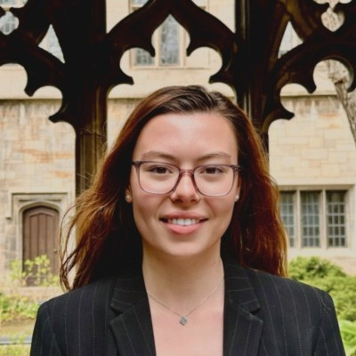
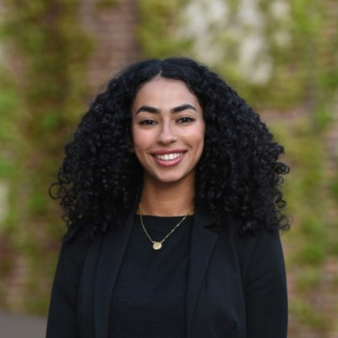
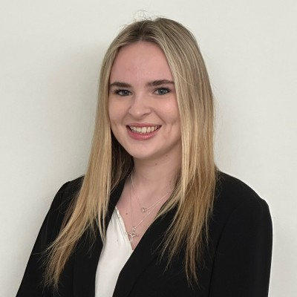
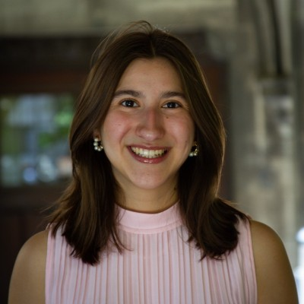
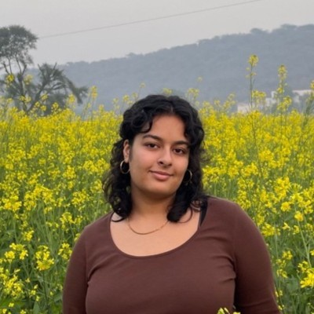
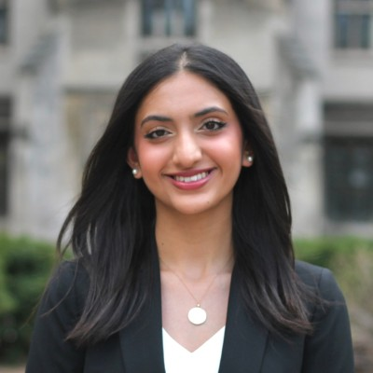
Questions & Resources
Contact the EC Case Competition Team with Any Questions
Jillian Robertson
Leena Tantaway
Sophie Burgess
Jacinta Lopez
Panchali Choudhary
Sophia Gilani

